Slide 1
What is Health Psychology?

Slide 2
When you hear “health psychology,” what comes to mind?

Slide 3
Important Terms
Health Psychology – the study of what makes people either ill or well, and what people experience throughout sickness
Health- “a complete state of physical, mental, and social well-being and not merely the absence of disease or infirmity”
Unwellness- when health is diminished
Wellness- when health is thriving

Slide 4
Important Terms
Etiology- the origins or causes of an illness
The “why”
Ex: Studying how smoking causes lung cancer
Epidemiology- the study of the frequency, distribution, and causes of a disease in a population
The “what, where, when”
Ex: Studying why the bubonic plague became a pandemic in the 1300s

Slide 5
Important Terms
Morbidity- the number of cases of a disease at a given point in time
Incidence- the number of new cases/ incidents
Ex: In 2025, it is estimated that there will be 2,041,910 new cases of cancer of any site.*
Prevalence- the total number of cases
Ex: In 2022, there were an estimated 18,000,110 people living with cancer of any site in the United States.*
Mortality- the number of deaths due to that particular disease
Ex: In 2025, it is estimated that 618,120 people will die of cancer.*
*National Cancer Institute https://seer.cancer.gov/statfacts/html/all.html

Slide 6
Important Terms
Acute- short-term
Example of an acute disorder: measles
Chronic- long-term
Example of a chronic disorder: Type 1 diabetes

Slide 7
Important Terms
Stress
Psychosomatic- refers to when a physical state (like an illness) is either caused or impacted by one’s mental
“psycho” = relating to the mind; “somatic” = relating to the body
Stomach Ulcers

Slide 8
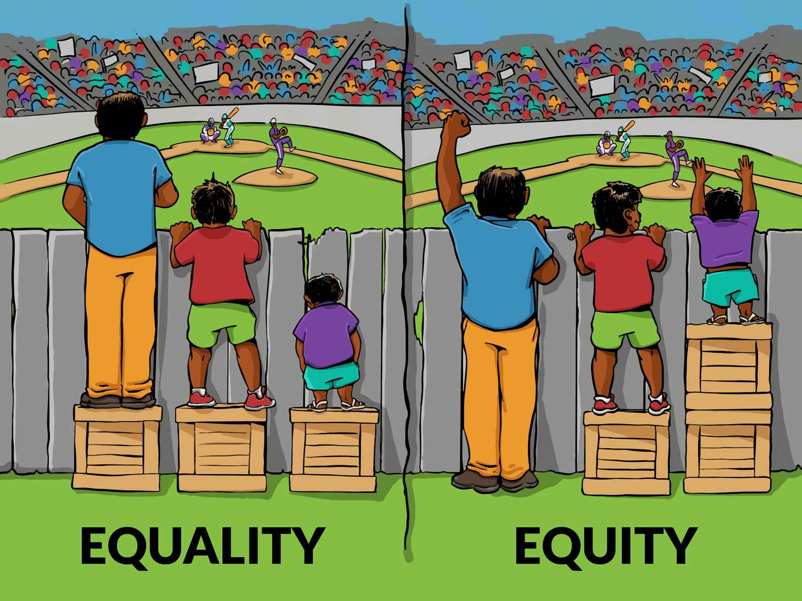
Important Terms
Equality – every person gets the same treatment/ resources
Equity – every person gets the same outcome, with resources based on need
Equitable healthcare – being intentional in the allotment of resources so individuals with the most need can receive more assistance
This Photo by Unknown Author is licensed under CC BY

Slide 9
Important Terms
Intersectionality – the overlap of two or more areas of life, that can cause an additional burden to an individual
Example: A patient requires wheelchair use AND lives in a rural area
Wheelchair use barriers: may require assistance for transportation
Rural area barriers: may not have necessary specialists
Intersectionality barriers: the lack of public transportation to a city with the specialist means the patient may not be able to see a specialist at all, or have added family/ financial burden to receive care

Slide 10
Important Terms
Theory- an idea (or set of ideas) that explains something that has occurred
A well-developed theory is testable
I theorize that cancer-related cognitive decline is caused by inflammation
Experiment- a study where a researcher creates two (or more) conditions, to determine how each condition may have a different impact on the results
Ex: Sending one group of students (condition A) to participate in tutoring, while sending another group of students (condition B) to study alone, then analyzing the difference in exam grades
Ex 2: Comparing a medicine to a placebo
Observational research- a type of research where instead of directly intervening to cause a reaction, just observing what happens naturally
Ex: Comparing how many hours a student spent studying to their exam score
Evidence-based medicine- medicine that has gone through multiple stages of experiments to test for effectiveness

Slide 11
Research Designs
Research Type | Definition | Example
Randomized Clinical Trial | A series of experiments to test the effectiveness of a treatment | Testing the ability of a yoga intervention to improve cancer survivorship
Correlational Research | An observational study comparing how one variable changes in conjunction with another variable | Comparing ice cream sales to temperature for a given week
Prospective Research | A research design to assess how people can change over time (can be experimental or observational) | Assessing how exercise levels impact heart disease development
Longitudinal Research | The main form of prospective research; a study where you track variables across a length of time | Tracking sugar intake and sleep quality
Retrospective Research | Research looking at existing data (or trying to recreate it) to understand why something happened in the past | Research to determine the cause of the bubonic plague
Meta-analysis | A study of studies, to determine trends and underlying causes | Combining multiple studies on miscarriages, to determine if a substantial proportion of the articles reported high levels of stress

Slide 12
Why should you care about research in a health psychology course?
Because research reshaped our understanding of health and continues to do so to this day.

Slide 13
A BRIEF History of Health Research
Believed diseases were caused by evil spirits
Disease was a spiritual punishment
Health attributed to bodily functions (thanks to autopsies)
Health was due to the 4 humors
Biomedical model (body and brain)
Biopsychosocial model (impacts in all directions)
Prehistoric
Ancient Greeks
Middle Ages
Renaissance
19th Century
Modern

Slide 14
Overarching Health Models
Biomedical Model – all illnesses are attributed to biochemical imbalances or neurophysiological abnormalities
Biopsychosocial Model – health is driven by the interplay of physical, psychological, and social factors
Psychological
Biological
Social

